Slide 1


compare different image acquisition devices such as digital cameras, scanners, satellite sensors, and medical imaging systems by explaining their working principles and applications.
SIMATS ENGINEERING
SAVEETHA INSTITUTE OF MEDICAL AND TECHNICAL SCIENCES
Technical presentation
ITA0506_SLOT D_COMPUTER VISION
GUIDED BY:
R.C. JENI GRACIA
PRESENTED BY:
K. SRIDHARAN(192421335)

Slide 2
Introduction
Digital Camera: Uses a CCD sensor to capture images. Used in photography and video recording.
Scanner: Uses light sensors to convert documents into digital images. Used for document scanning.
Satellite Sensor: Captures Earth images from satellites. Used for weather, mapping, and agriculture.
Medical Imaging System: Uses X-ray, CT, MRI, or Ultrasound to image the
human body. Used for medical diagnosis.

Slide 3
Types of Image Acquisition Devices
Major Devices
📷 Digital Cameras
📄 Scanners
🛰️ Satellite Sensors
🏥 Medical Imaging Systems
Purpose
Capture images for different applications.

Slide 4
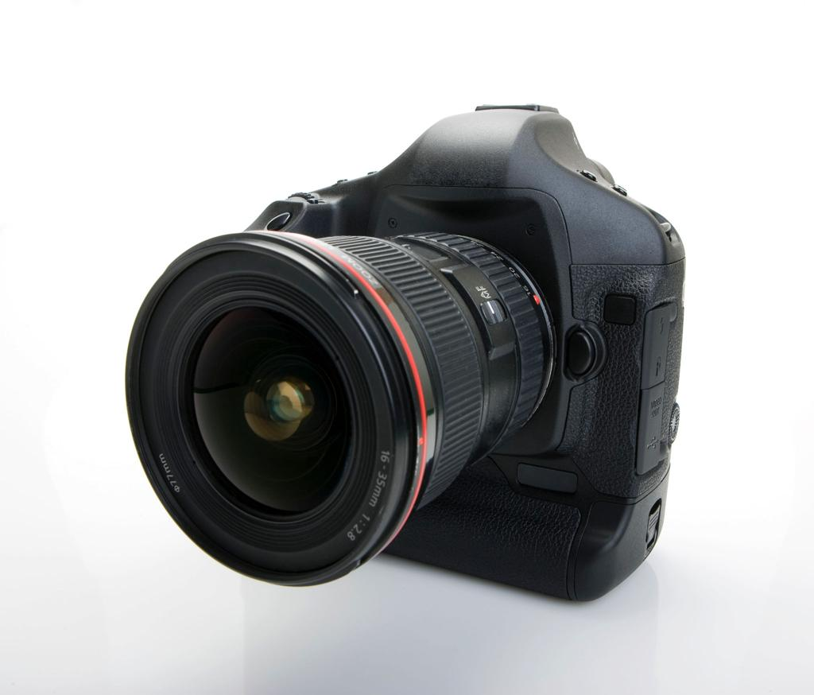
Digital Cameras
Working Principle
Lens focuses light onto an image sensor (CCD/CMOS).
Sensor converts light into electrical signals.
Processor converts signals into a digital image.
Applications
Photography
Surveillance
Mobile phones
Computer Vision
Social Media

Slide 5
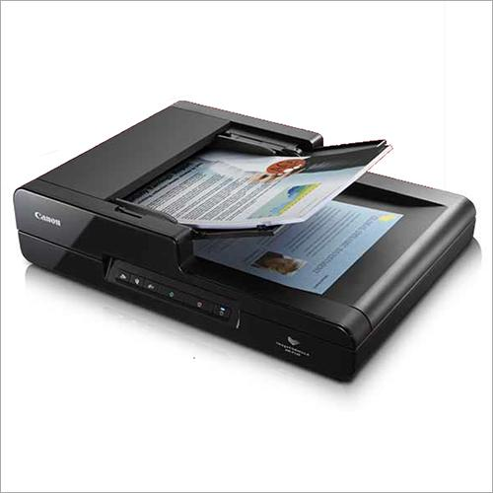
Scanners
Working Principle
A light source scans the document.
Reflected light is captured by CCD/CIS sensors.
Image is converted into digital format.
Applications
Document scanning
OCR (Optical Character Recognition)
Book digitization
Office automation

Slide 6
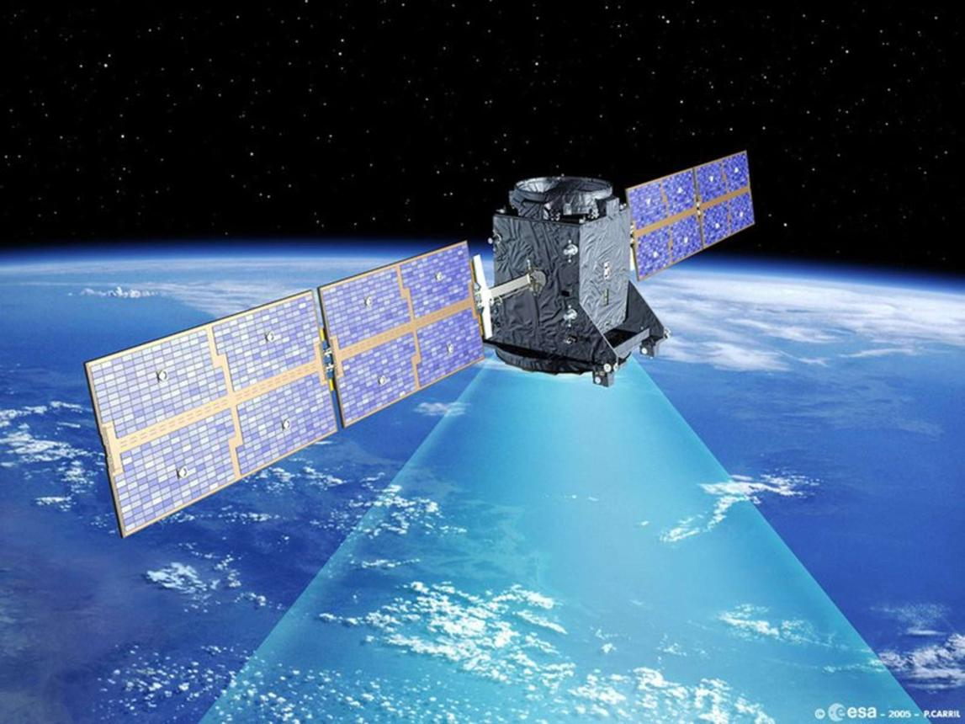
Satellite Sensors
Working Principle
Sensors capture reflected sunlight or emitted thermal energy.
Data is transmitted to Earth stations.
Images are processed for analysis.
Applications
Weather forecasting
Agriculture
Disaster monitoring
Mapping
Environmental monitoring

Slide 7
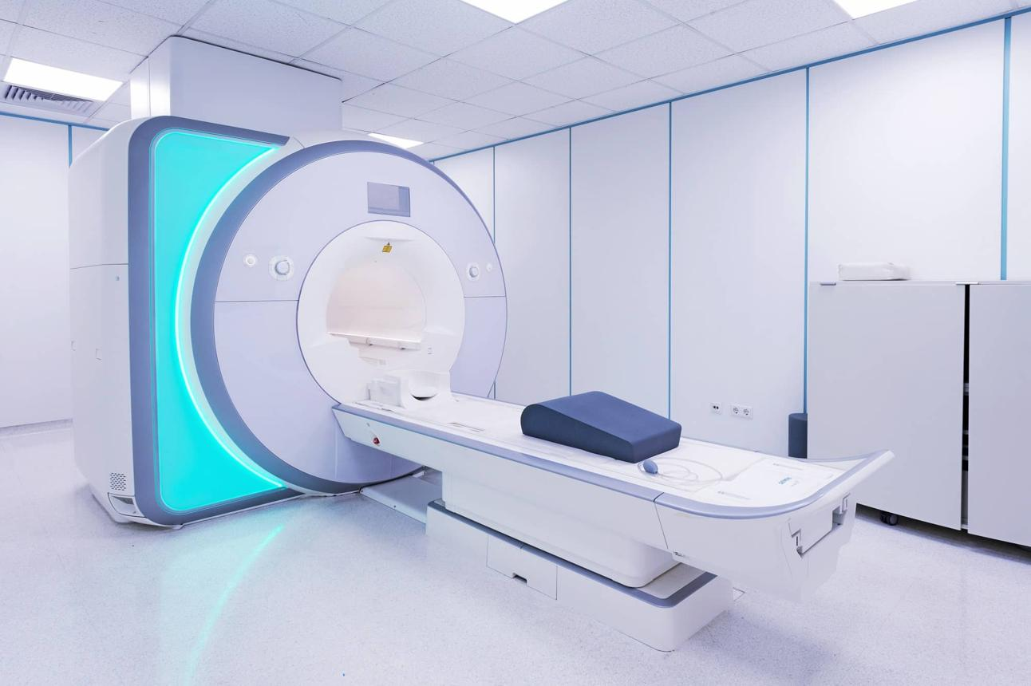
Medical Imaging Systems
Working Principle
Different technologies capture images of the human body.
X-ray → Uses X-rays
CT Scan → Multiple X-rays
MRI → Magnetic field & radio waves
Ultrasound → Sound waves
Applications
Disease diagnosis
Surgery planning
Cancer detection
Bone fracture detection

Slide 8
Comparison Table
Device | Technology Used | Main Application
📷 Digital Camera | CCD Sensor | Photography, Mobile Cameras, Surveillance
📄 Scanner | Contact Image Sensor | Document Scanning, OCR, Book Digitization
🛰️ Satellite Sensor | Remote Sensing Sensors (Optical, Infrared, Thermal) | Weather Forecasting, Mapping, Agriculture, Disaster Monitoring
🏥 Medical Imaging System | X-ray, CT Scan, MRI, Ultrasound | Disease Diagnosis, Healthcare, Medical Treatment

Slide 9
LIMITATIONS
High-quality devices are expensive.
Image quality may be affected by noise and lighting.
Large image files require more storage.
Some devices need regular calibration and maintenance.
Environmental conditions can reduce image accuracy.

Slide 10
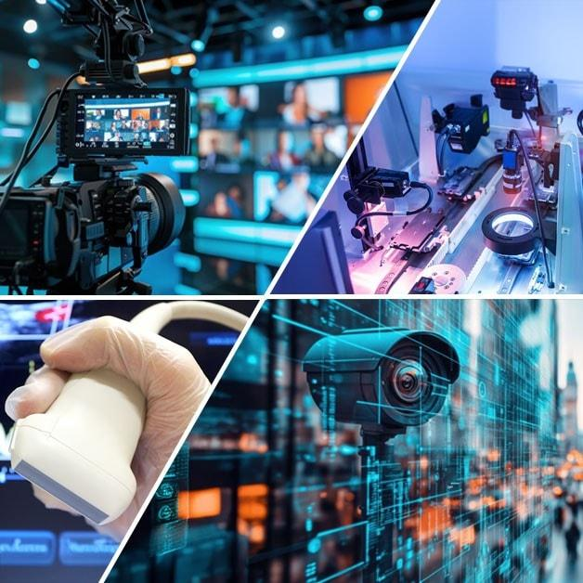
CONCLUSION
Image acquisition is the first step in image processing.
Different devices use different technologies.
Each device has unique applications. Choosing the right device depends on the purpose.
Image acquisition plays a vital role in modern technology.

Slide 11


